Slide 1
CORPORATE PRESENTATION
ONLINE WEB BASED MONITORING
OF
WATER RESOURCES
WELCOME
ARUSHI BHALLA
MANISH MEHTA
07-Nov-16
EXCELLENCE THROUGH INGENUITY

Slide 2
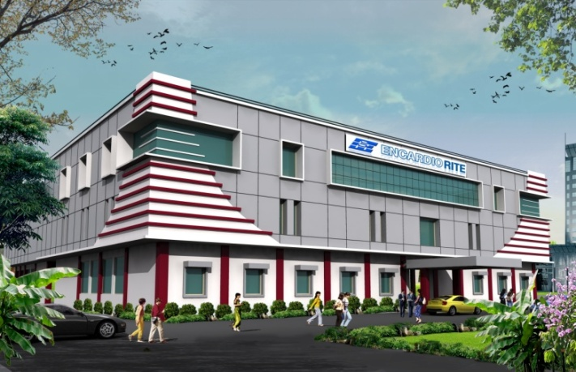
MILESTONES
INCORPORATED IN JUNE 1966
ISO 9001:2008 CERTIFICATED FIRM BY DNV OF THE NETHERLANDS.
D&B RATING OF 4A1.
EXCELLENT IN-HOUSE R&D FACILITIES, RECOGNIZED BY GOVERNMENT OF INDIA.
TOTAL EMPLOYMENT AROUND 400 PERSONNEL WITH AROUND 100 ENGINEERS.
ALMOST 65 % OF OUR TURNOVER IS IN FOREIGN EXCHANGE FROM AROUND 50 COUNTRIES ACROSS THE WORLD.
WITH 50 YEARS OF EXPERIENCE, ENCARDIO-RITE GROUP OF COMPANIES ARE EXECUTING NUMBER OF PROJECTS ON TURNKEY BASIS, PROVIDING SUPPORT FROM DESIGNING TO SUPPLYING TO INSTALLATION TO DATA RETRIEVING TO MONITORING TO ONLINE PRESENTATION OF DATA.

Slide 3
ENCARDIO-RITE GROUP …
Encardio-rite Geosystems LLC UAE
Encardio-rite Geosystems WLL Bahrain
Condor Gulf Technologies Company Ltd. Saudi Arabia
ENCARDIO
RITE
Encardio-rite Electronics Pvt. Ltd. in Bhutan
Rite Geosystems WLL Qatar
Encardio-rite
Europe
Rite Geosystems Pte. Ltd. Singapore

Slide 4
ONE STOP FOR MONITORING SOLUTIONS
REMOTE ONLINE WEB BASED MONITORING
SUPPORTED BY IN-HOUSE R&D
MANUFACTURE OF SENSORS & DATALOGGERS
TURNKEY SOLUTIONS FOR SUPPLY, INSTALLATION
MONITORING &
DATA MANAGEMENT
IN-HOUSE SOFTWARE DEVELOPMENT
DRISHTI
INCLINOVIEW ETC.
GROUP
STRUCTURAL HEALTH MONITORING
GEOTECHNICAL MONITORING
ENVIRONMENTAL MONITORING:
WATER LEVEL
WATER QUALITY
WEATHER
NOISE, VIBRATION, SEISMIC
GEODETIC MONITORING, LAND SURVEYING, AERIAL MAPPING OPTICAL SURVEYING, LASER SCANNING

Slide 5
MONITORING SOLUTIONS FOR WATER LEVEL

Slide 6
WATER MONITORING SYSTEM
WATER LEVEL MONITORING SYSTEM ESSENTIALLY CONSISTS OF:
ABSOLUTE PRESSURE SENSOR (COMPLETELY SEALED) WITH TEMPERATURE SENSOR & INTEGRAL CABLE
AUTOMATIC DATALOGGING SYSTEM
BOX MODEL
BOREHOLE MODEL
BAROMETRIC PRESSURE SENSOR
RAIN GAUGE
ONLINE WEB BASED DATA MONITORING SERVICE

Slide 7
WATER MONITORING SYSTEM
BOX MODEL DATALOGGER
BOREHOLE MODEL DATALOGGER WITH SENSOR

Slide 8
WATER MONITORING SYSTEM
FOR EFFICIENT WATER MANAGEMENT, IT IS ESSENTIAL TO MAP, MEASURE AND MONITOR EXTENT OF BOTH SUB SOIL AQUIFERS AND SURFACE FRESH WATER RESOURCES.
EASIEST METHOD FOR AUTOMATIC RECORDING IS TO USE A WATER PRESSURE SENSOR WHICH MEASURES WATER LEVEL USING RELATIONSHIP THAT PRESSURE IS EQUIVALENT TO 10 KPA FOR EVERY 1 M OF WATER COLUMN FOR PURE WATER OF SPECIFIC GRAVITY 1.00.
BRACKISH WATER IN COASTAL AREAS OFTEN HAS A SPECIFIC GRAVITY AS HIGH AS 1.1 & THEREFORE REQUIRES SPECIFIC GRAVITY CORRECTION IN THE MEASURED VALUE. THIS CORRECTION IS EASILY DONE IN THE DATALOGGER

Slide 9
CHALLENGE
PRESSURE SENSOR HOWEVER MEASURES DEPTH OF WATER COLUMN AS WELL AS ATMOSPHERIC PRESSURE. TO GET THE CORRECT WATER TABLE/LEVEL, THE VALUE OF ATMOSPHERIC PRESSSURE HAS THEREFORE TO BE DEDUCTED FROM THE PRESSURE SENSOR READING.
THE PROBLEM IS THAT ATMOSPHERIC PRESSURE VARIES BY A LARGE AMOUNT ON A DAILY BASIS AND THEREFORE A CONSTANT FACTOR CANNOT BE USED FOR THE CORRECTION. READINGS FROM PRESSURE SENSORS WITH MEASURING RANGE UPTO 30 MWC NEED BAROMETRIC PRESSURE CORRECTION.
VARIATION OF ATMOSPHERIC PRESSURE WITH TIME OVER A PERIOD OF ONE YEAR IS ILLUSTRATED BY THE GRAPH IN THE NEXT SLIDE.

Slide 10
EFFECT OF ATMOSPHERIC PRESSSURE

Slide 11
EFFECT OF ATMOSPHERIC PRESSSURE
IN THE GRAPH, A VARIATION OF 299 MM WCL WAS OBSERVED DURING ONE YEAR COVERING WINTERS AND SUMMERS
IT HAS BEEN OBSERVED THAT ON A DAILY BASIS AT ANY LOCATION ATMOSPHERIC PRESSURE CAN VARY UP TO 200 MM WATER COLUMN (WCL).
ON AN ANNUAL BASIS, VARIATION MAY GO UP TO 300 MM WCL OR EVEN MORE. OVER A PERIOD OF YEARS A VARIATION OF 500 MM WCL HAS BEEN DOCUMENTED AT SEVERAL PLACES
ONE CAN THEREFORE IMAGINE THE KIND OF IMPACT IT HAS ON THE ACCURACY OF THE MONITORED WATER TABLE

Slide 12
ADVANCES IN TECHNOLOGY
SOLUTIONS UPTIL NOW TO ACCOUNT FOR VARIATIONS IN ATMOSPHERIC PRESSURE, MOSTLY USED A GAUGE PRESSURE SENSOR WITH ONE SIDE OF ITS PRESSURE MEASUREMENT DIAPHRAGM OPEN TO ATMOSPHERE THROUGH A VENT TUBE IN THE CABLE
A DESICCANT CHAMBER WAS ADDITIONALLY REQUIRED TO PREVENT MOISTURE FROM ENTERING INTO THE VENT TUBE. THE COLOUR OF THE DESICCANT CHANGES WITH ABSORPTION OF MOISTURE, INDICATING THAT IT HAS TO BE REPLACED. IF NOT REPACED IN TIME, IT IMPAIRS THE PERFORMANCE OF THE WATER LEVEL MONITORING SYSTEM.
ENCARDIO-RITE USES A BETTER OPTION BY PROVIDING AN INDIVIDUAL BAROMETRIC PRESSURE SENSOR WITH EACH LEVEL SENSORS AND MAKING CORRECTION FOR ATMOSPHERIC PRESSURE CHANGES AUTOMATICALLY IN THE DATALOGGER THUS INCREASING THE RELIABILITY OF THE SYSTEM.

Slide 13
ADVANTAGES OF E-R SYSTEM
THE ENCARDIO-RITE SYSTEM DOES NOT USE ANY DESICCANT. THIS REDUCES REGULAR MAINTENANCE AS DESICCANTS HAVE TO BE CHANGED AT REGULAR INTERVALS ESPECIALLY IN REGIONS WITH HIGH MOISTURE CONTENT OR HEAVY RAINFALL.
MAINTENANCE IS FURTHER REDUCED BY USING HIGH POWER LITHIUM BATTERIES WHICH LAST MORE THAN FIVE YEARS FOR DATA RETRIEVAL UPTO FOUR TIMES A DAY AND DATA TRANSFER BY GSM/GPRS ONCE A DAY FOR ONLINE WEB BASED MONITORING.
SYSTEM ALSO PROVIDES DATA ON BAROMETRIC PRESSURE WITHOUT ANY ADDITIONAL COST.

Slide 14
COMPARISON DATA

Slide 15
COMPARISON DATA

Slide 16
RESULTS
THE SYSTEM WITH ABSOLUTE PRESSURE SENSOR AND NON-VENTED CABLE IS BETTER THAN THE ONE WITH THE VENTED TUBE BECAUSE:
DESICCANT HAS NOT TO BE CHANGED AT REGULAR INTERVALS
AN ABSOLUTE PRESSURE SENSOR IS USED IN THE FORMER WHICH IS MUCH MORE RELIABLE THAN GAUGE PRESSURE SENSORS WHICH USE “0-RINGS” FOR PROTECTION
BAROMETRIC PRESSURE IS ALSO AVAILABLE AS AN ADDITIONAL PARAMETER

Slide 17
RAIN GAUGE
ANOTHER IMPORTANT PARAMETER IS “MONITORING OF RAINFALL” THAT AFFECTS WATER LEVEL IN THE GROUND, RIVERS AND LAKES. IT PROVIDES VALUABLE INFORMATION ON CORRELATION BETWEEN RAINFALL AND MAGNITUDE OF PERCOLATION OF RAIN WATER INTO ACQUIFER OVER A PERIOD OF TIME.
RAIN GAUGES ARE INSTALLED IN THE OPEN AND SUBJECT TO DIRECT SUNLIGHT AND WEATHER. FOR REMOTE LOCATIONS, HEAVY DUTY RAIN GAUGES WITH STAINLESS STEEL HOUSING SHOULD BE SPECIFIED AS THEY CAN WORK FOR DECADES WITHOUT DEGRADATION AND TURN OUT TO BE MORE ECONOMICAL IN THE LONG RUN.

Slide 18
CONDUCTIVITY MEASUREMENT
VARIATION OF PRESSURE SENSOR, KNOWN AS CTD (CONDUCTIVITY, TEMPERATURE, DEPTH) IS AVAILABLE WITH AN INTEGRAL CONDUCTIVITY SENSOR.
CONDUCTIVITY MEASUREMENT GIVES A MEASURE OF SALINITY OF THE WATER FROM WHICH THE DENSITY OF THE WATER CAN BE CALCULATED.
THIS KIND OF SENSOR IS INDISPENSIBLE IN AREAS WHERE THE SALINITY OF THE GROUND WATER VARIES WITH TIME.

Slide 19
INDIA – ALL SITES
AUTOMATIC WATER LEVEL MONITORING SYSTEMS IN DIFFERENT STATES OF INDIA
122.15.209.75:50005/webdata
ewlrsites

Slide 20
UTTAR PRADESH

Slide 21
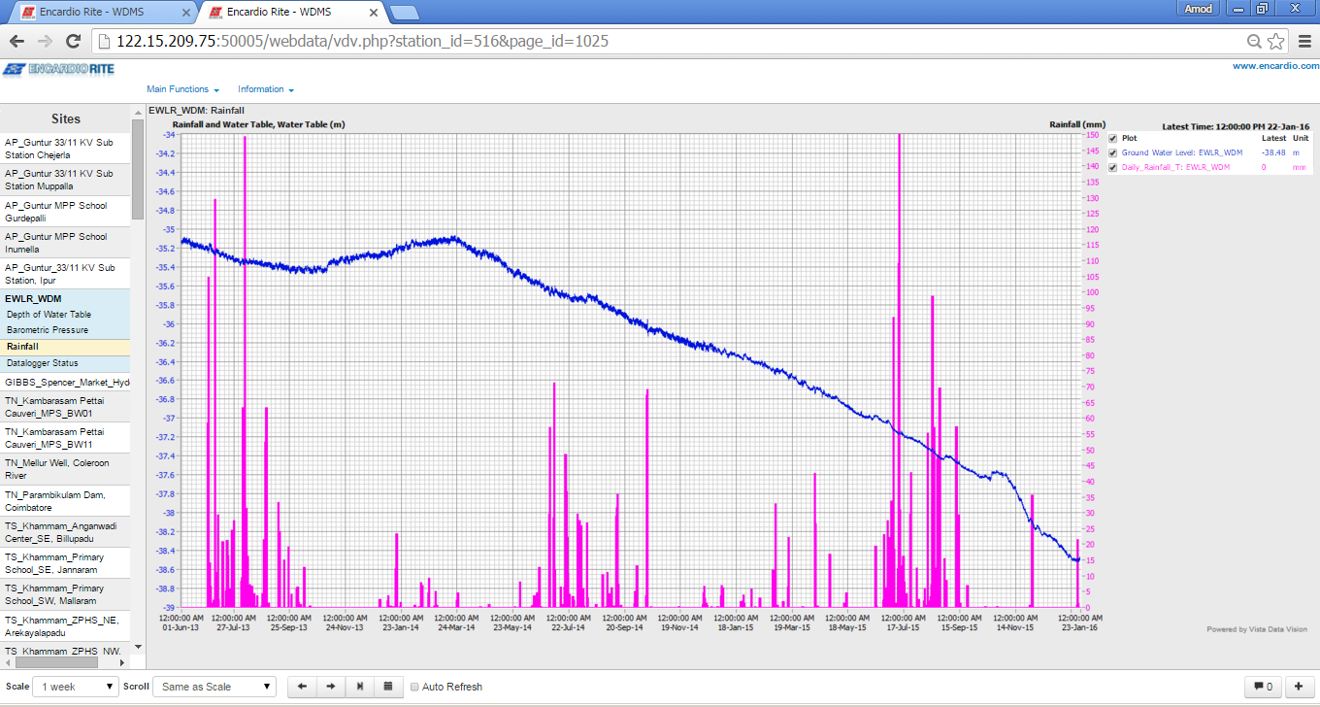
WDMS MONITORING RESULT

Slide 22
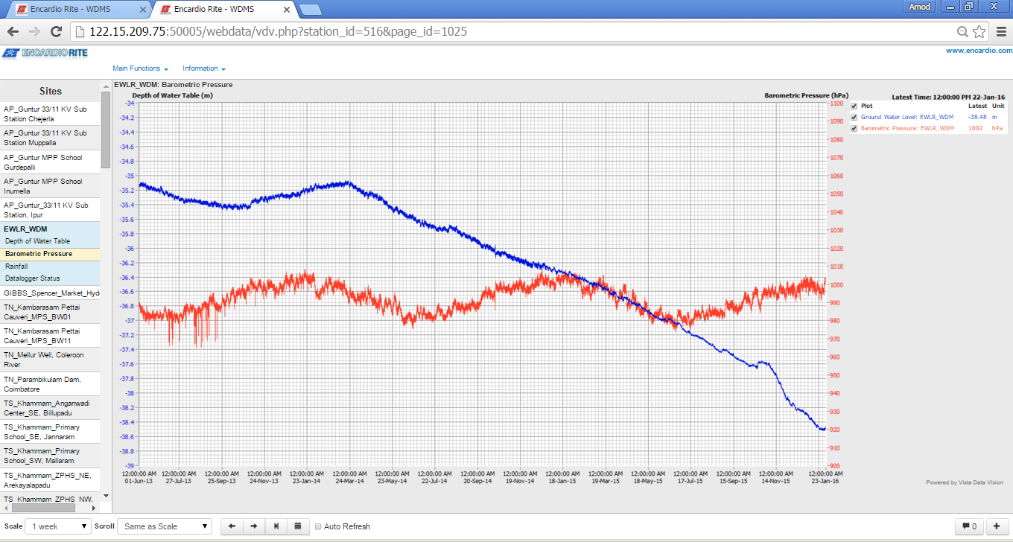
WDMS MONITORING RESULT

Slide 23
SUCCESS STORY
OUR ORGANISATION INSTALLED 600 ONLINE WEB BASED MONITORING SYSTEMS FOR THE VARIOUS GOVERNMENT ORGANISATIONS SINCE JAN 2014.
THE SYSTEMS AUTOMATICALLY TAKE TWO READINGS OF GROUND WATER LEVEL A DAY AND TRANSMIT THEM TO A CENTRAL SERVER AT NIGHT. THUS 60 READINGS ARE TAKEN PER BOREHOLE EVERY MONTH AND AUTOMATICALLY RECORDED IN THE DATA BANK.
SINCE INSTALLED, UP TO NOVEMBER 2, 2016 A SET OF 8,21,714 READINGS HAVE BEEN AUTOMATICALLY LOGGED. OUT OF THESE 8,09,113 READINGS ARE GOOD I.E. A SUCCESS RATE OF 98 %. THE 12601 READINGS THAT ARE NOT GOOD ARE BECAUSE OF SPIKES OR BEING ERRATIC.
THE SUCCESS RATE IS ABSOLUTELY UNBEATABLE.

Slide 24
SUCCESS STORY
 | NUMBERS | DATA | SPIKES | GOOD DATA | DATE INSTALLED
GWD AGRA | 200 | 229670 | 695 | 228975 | May-15
SWID KOLKOTTA | 60 | 57672 | 30 | 57642 | Mar-16
TWAD TAMIL NADU | 176 | 21440 | 2099 | 19341 | Apr-15
UP | 30 | 46457 | 214 | 46243
DoA ASSAM | 37 | 186288 | 122 | 186166 | Mar-15
HP II PUDUCHERRY | 50 | 131768 | 4700 | 127068 | May-14
WRID,PUNJAB | 10 | 148419 | 4741 | 143678 | Jan-14
APWSIP , AP | 25 |  |  |  | Sept-14
TOTAL | 588
PERCENTAGE OF GOOD READINGS |  |  |  | 98%

Slide 26
SUGGESTIONS
WE SHOULD USE THE BOX TYPE DATALOGGER WITH THE ANTENNA ON TOP AS THE DATA CONNECTIVITY IN MOST PARTS OF THE COUNTRY IS NOT GOOD.
WE SHOULD USE A NON VENTED SYSTEM FOR EASIER MAINTAINENCE.

Slide 27
OTHER SYSTEMS

Slide 28
WATER QUALITY MONITORING
ENCARDIO-RITE AUTOMATIC WATER QUALITY MONITORING SYSTEM OFFERS A RANGE OF SENSORS THAT MONITOR VARIOUS WATER QUALITY PARAMETERS. ANY COMBINATION OF SENSORS CAN BE USED DEPENDING ON APPLICATION, PRECISE MONITORING NEED, MEASUREMENT LOCATION OR TYPE OF INDUSTRY.
TSS/TURBIDITY SENSOR

Slide 29
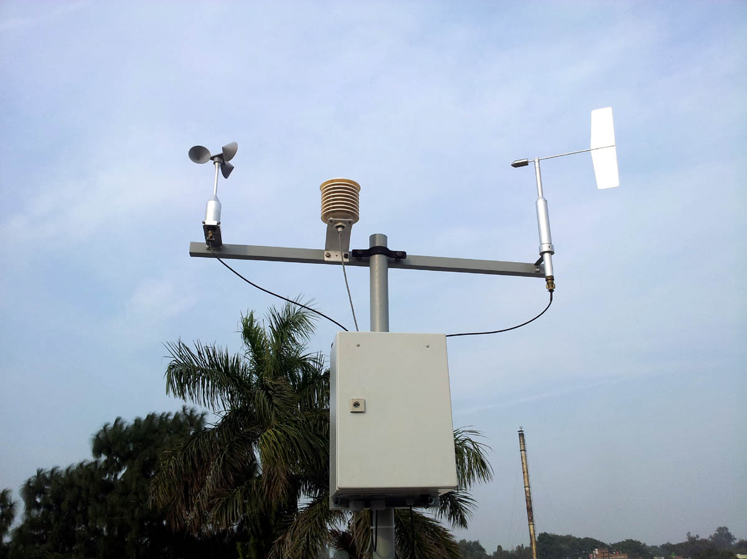
Online weather station
Encardio-rite automatic weather station is a weather data management and presentation system for meteorological data collected by individual sensors from a site. The system provides a reliable and cost effective means of recording meteorological data
RAIN GAGE/PRECIPITATION
WIND SPEED
WIND DIRECTION
TEMPERATURE
HUMIDITY

Slide 30
THANK YOU

